Slide 1





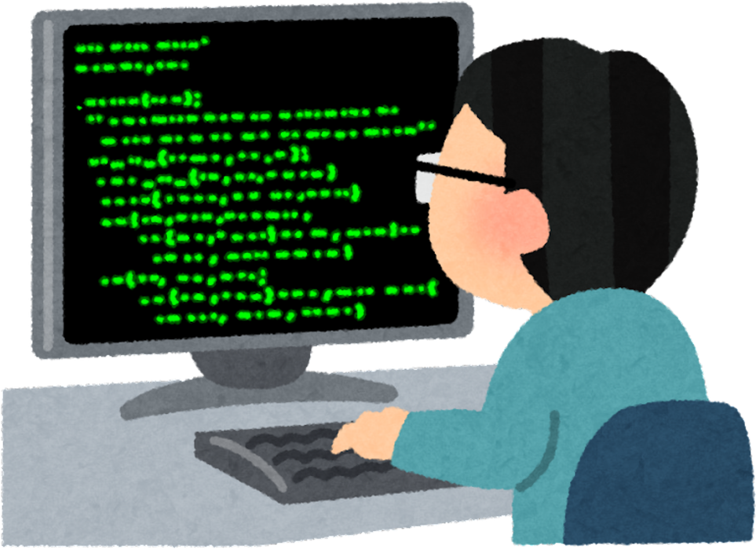


ThreatGuard : A Lightweight Intrusion Detection &
Secure Authentication System (C++)
Presented By:
MD Iftiur Hossen Riyad(2404011)
Momtasin Tamanna(2404012)
Presented to:
Md Masud Rana
Lecturer, Department Of Cyber Security Engineering,UFTB
1

Slide 2


introduction
ThreatGuard is a lightweight Intrusion Detection and Secure Authentication System developed using C++. It provides secure user registration, login authentication, password validation, password hashing, and activity logging. The system also detects suspicious login attempts and helps improve overall security. Its main goal is to demonstrate basic cybersecurity concepts in a simple and effective way.
2

Slide 3


Project Objectives
Secure user registration
Brute-Force Detection
Secure login authentication
Automatic Account Lock
Password Hashing
Security Logging
Admin Control Panel
3

Slide 4
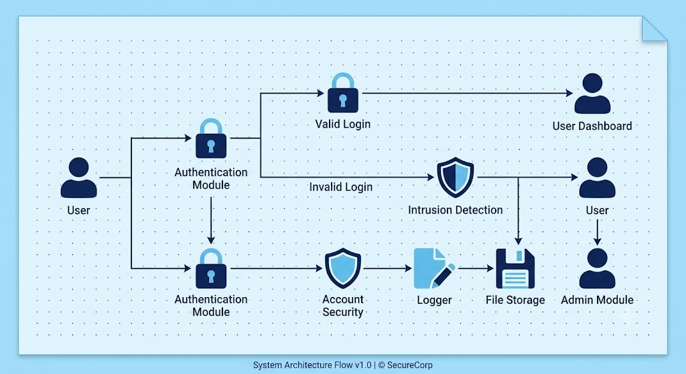
System Architecture
4

Slide 5
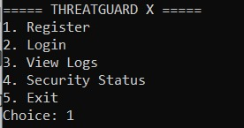
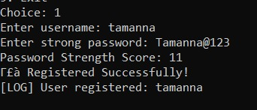
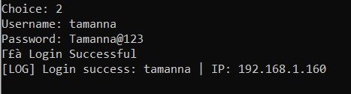
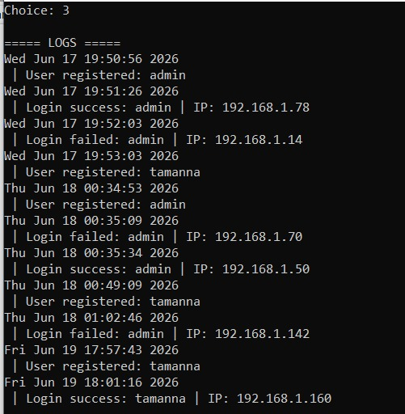

Output
1
2
3
4
5
5

Slide 6

Advantages
Enhances user account security.
Reduces the risk of unauthorized access.
Protects against common password attacks (e.g., brute-force attacks).
Encourages users to create strong and secure passwords.
Prevents the use of weak and easily guessable passwords.
Improves the overall security of the authentication system.
6

Slide 7

Disadvantages
Users may find strong passwords difficult to remember.
Password creation becomes more time-consuming.
Users may forget complex passwords and need frequent resets.
Strict password rules can reduce user convenience.
Some users may write down passwords, creating additional security risks.
7

Slide 8
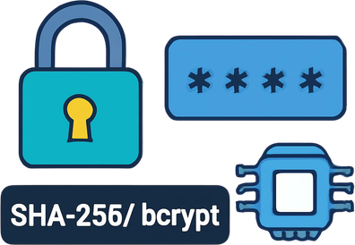


Future Scope
Stronger Password Encryption
(SHA-256 / bcrypt)
Secure Database Integration
(MySQL / SQLite)
Real-Time IP Tracking & Network Monitoring
8

Slide 9
Conclusion
ThreatGuard is a lightweight Intrusion Detection and Secure Authentication System developed using C++. It provides secure user registration, password validation, password hashing, login authentication, activity logging, and threat detection. By monitoring failed login attempts and suspicious activities, the system improves overall security and demonstrates fundamental cybersecurity concepts in a simple and effective manner.
9

Slide 10
Thank
You Everyone
And special thanks to our honourable
Md Masud Rana
Lecturer
Department Of Cyber Security Engineering, UFTB
for giving us the opportunity.
Presented By:
MD Iftiur Hossen Riyad(2404011)
Momtasin Tamanna(2404012)
10

